Slide 1
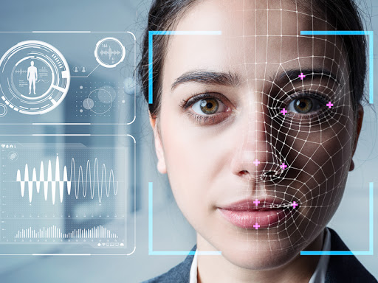
HUMAN FACE RECOGNITION
Using MACHINE LEARNING

Slide 2
Project Details
Project Guide:
Dr. K. Veera Swamy, M.Tech , Ph.D., Professor
Project Seminar by:
Tadigadapa Mahesh Kumar
(1602-17-735-027)
Gundrati Saketh Kumar Goud
(1602-17-735-045)
Kumbargeri Supraja
(1602-17-735-056)

Slide 3
CONTENTS
Aim
Introduction
How does a machine read an image
Types of machine learning algorithms
Decision Tree
Support vector Machine (SVM)
Convolutional Neural Network (CNN)
Implementation
References
How to assess a ML model
Results

Slide 4
AIM
To design and implement Machine Learning models to recognise the human face based in the input image and the dataset
To compare and contrast the built models based on performance parameters

Slide 5
INTRODUCTION
HOW DOES A MACHINE READ AN IMAGE?

Slide 6
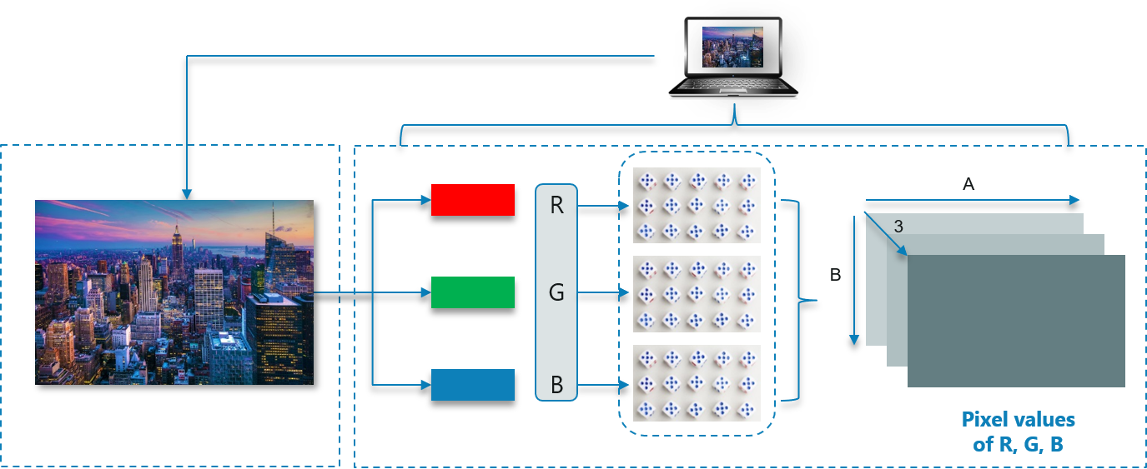

Slide 7
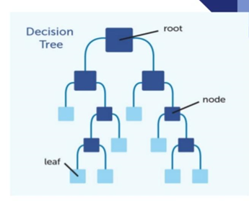
Decision Trees
Decision tree is a type of supervised learning algorithm that is mostly used in classification problems
The tree has three important nodes
Root node
Internal node
Leaf node

Slide 8
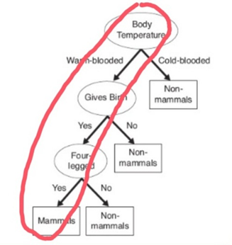
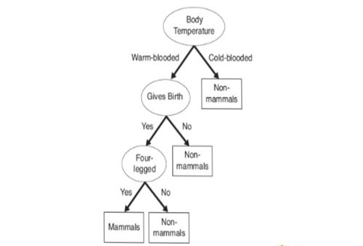
Example
Decision tree for mammal classification
For testing we have given animal like dog

Slide 9
PROS and CONS
PROS
CONS
Easy to understand and interpret
Robust
Can handle categorical and numerical data
Prone to Overfitting
Unstable
Requires complex calculations

Slide 10
Algorithms
ID 3
CART
C 4.5

Slide 11
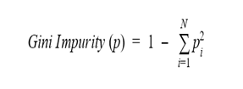
CART (Classification And Regression Tree)
The Gini index is based on Gini impurity. Gini impurity is defined as 1 minus the sum of the squares of the class probabilities in a dataset
Where p is the whole dataset, N is the number of classes, and p_{i} is the frequency of class i in the same dataset.

Slide 12
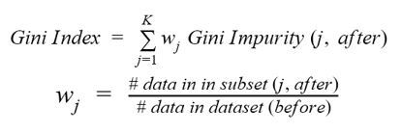
Where K is the number of subsets generated by the split and (j, after) is subset j after the split

Slide 13
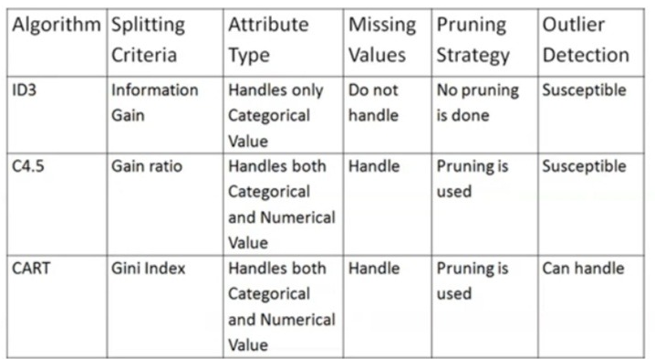

Slide 14
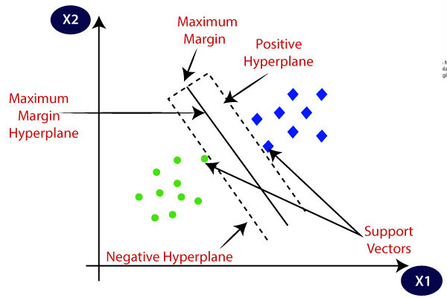
Support Vector Machine (SVM)
Terminology:
Hyperplane
Support Vectors
Margin

Slide 15
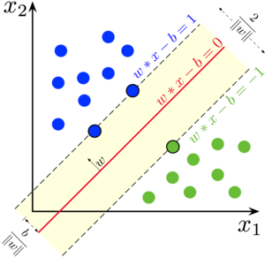
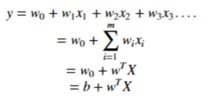
Features are based on
Colour
Shape
Texture

Slide 16
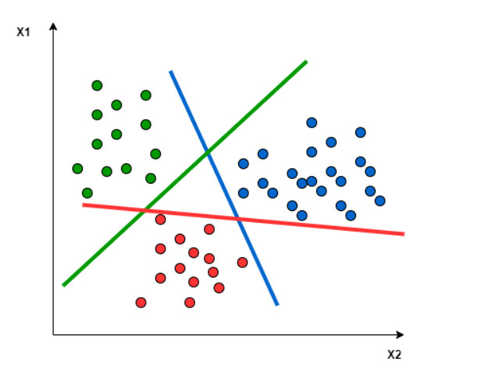
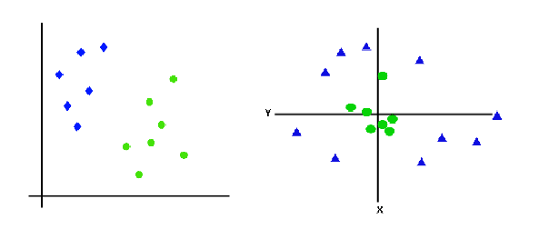
Types of SVM
Linear SVM
Non-Linear SVM

Slide 17
PROS and CONS
PROS
CONS
Memory efficient
Suitable for high dimension data
Better accuracy
Longer training time
Underperforms when the number of features exceed the number of training data samples

Slide 18
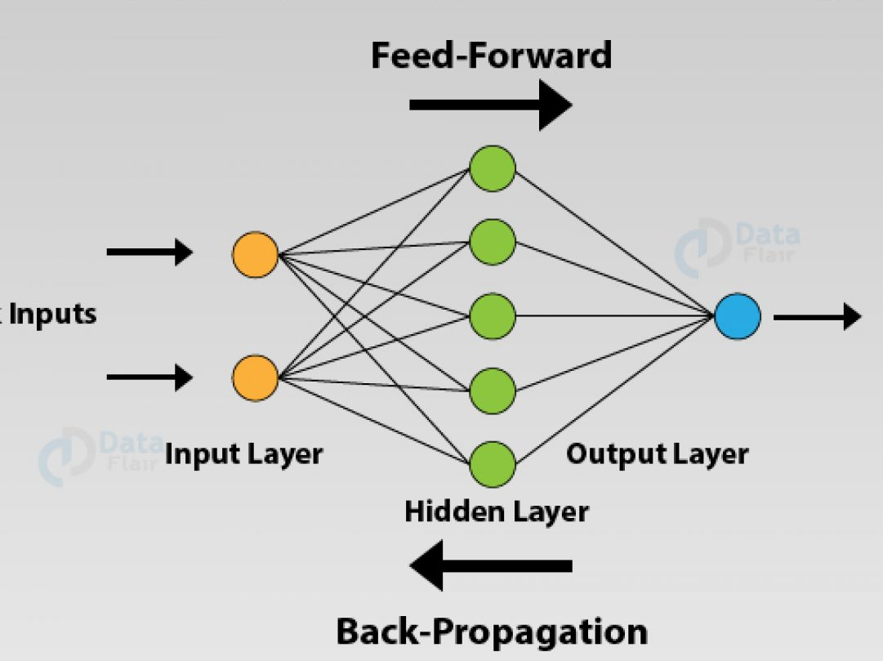
Convolutional Neural Network (CNN)
What is Neural Network?

Slide 19
Working of Neural Network
Weights
Bias
Transfer Function
Activation Function

Slide 20
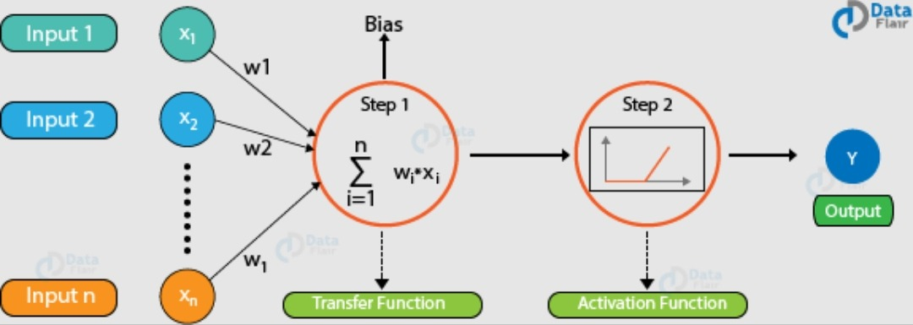

Slide 21
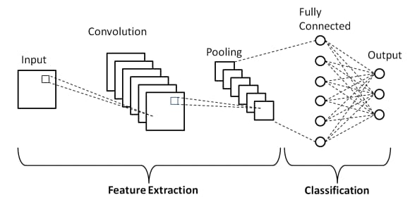
Architecture of CNN

Slide 22
PROS and CONS
PROS
CONS
Implicit feature extraction
Less pre-processing required
High accuracy
Prone to overfit
Longer training time
Slow in nature because of maxpooling

Slide 23
IMPLEMENTATION

Slide 24

HOW to ASSESS a ML MODEL

Slide 25
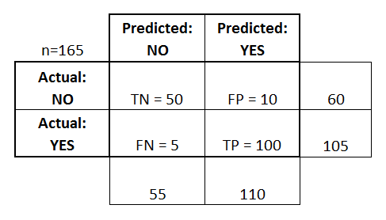
Confusion Matrix

Slide 26
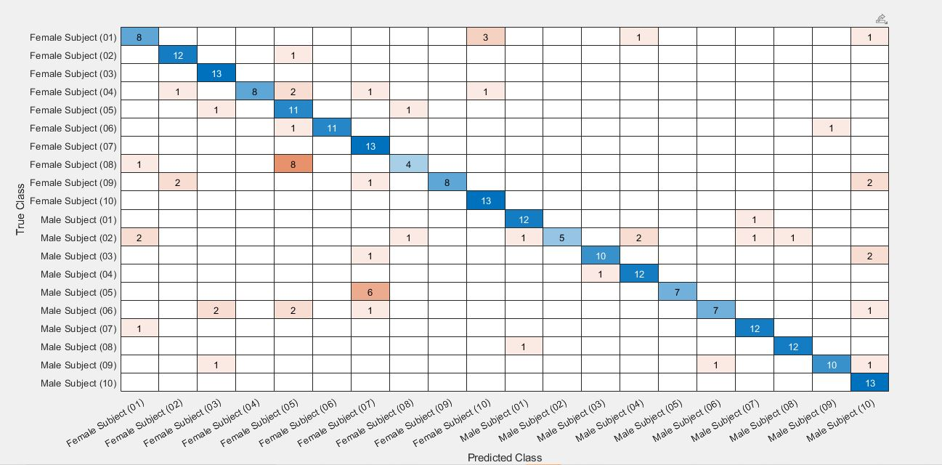

Slide 27

Performance Metrics
Accuracy
Precision
Recall
F1 Score

Slide 28
Accuracy
Accuracy is the "Total number of correct predictions divided by the Total number of predictions in testing dataset."
Accuracy = (TP + TN) / (TP + TN + FP + FN)
Where,
TP - ( True Positive )
FN - ( False Negative )
FP - ( False Positive )
TN - ( True Negative )

Slide 29
Precision and Recall
PRECISION is "The no. of True Positive divided by no. of all detected patterns"
Precision = TP / TP + FP
RECALL is "The no. of True Positive divided by no. of relevant patterns"
Recall = TP / TP + FN

Slide 30
'F1' Score
'F1' score is the harmonic mean of Precision and Recall
F1 Score = (2 * recall * precision) / (recall + precision)

Slide 31

RESULTS

Slide 32
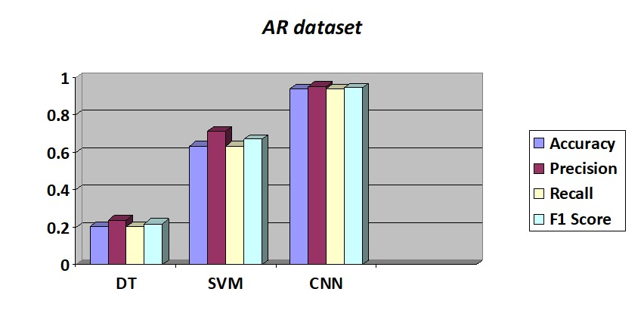

Slide 33
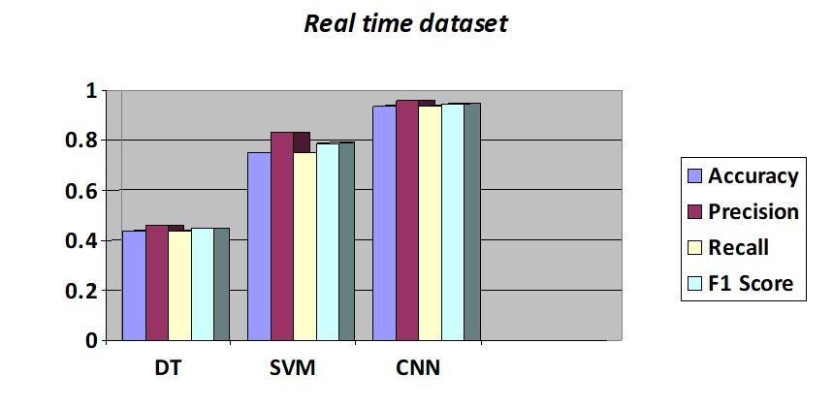

Slide 34
TimeLine
Progress made ( Up to : 27th April 2021 )
Done with implementation of Decision Tree model
Done with implementation of SVM model
(both the models on yale dataset, which consists of grayscale images only)
Progress to be made
Understanding the CNN related concepts - ( 10th May 2021 )
Implementation using CNN algorithm - ( 20th May 2021 ) ------ ( 27th May 2021 )
Comparison between all the three models built - ( 25th May 2021 ) ------ ( 3rd June 2021 )
Documentation - ( 10th June 2021 ) ------ ( 15th June 2021 )

Slide 35
References
http://www.dcs.gla.ac.uk/~vincia/textbook.pdf
https://papers.nips.cc/paper/1998/file/a2cc63e065705fe938a4dda49092966f-Paper.pdf
https://towardsdatascience.com/support-vector-machines-svm-c9ef22815589
https://algorithmia.com/blog/evaluating-machine-learning-models-with-a-confusion-matrix
https://www.mathworks.com/help/stats/fitctree.html
https://www.mathworks.com/help/vision/ref/extracthogfeatures.html
https://www.mathworks.com/help/stats/fitcecoc.html

Slide 36

THANK YOU

